Slide 1

Project 3
Interactive Dashboard
US Food Environment
University of Minnesota Data Visualization and Analytics Boot Camp
Team 8:
Jordan Jeranek, Chloe Li, Jason McHone, Omar Espinoza
January 30, 2023
Notes:
Suggested order:
Slides #1-3: Omar
Slides #4-5: Chloe
Slides #6-9: Jason (and/or Jordan?)
Slide #10: Omar
Slide #11-12: Jordan (and/or Jason?)

Slide 2
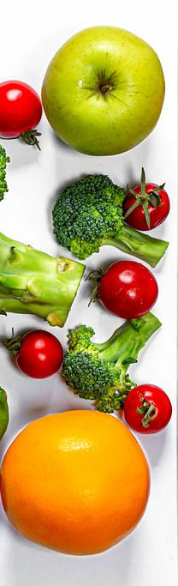
Project Description
Background: Food environment, specifically food accessibility, has been shown to influence dietary patterns, which ultimately affects nutrition-related diseases such as diabetes, obesity, and cardiovascular disease (Ly et al., 2020).
Objective: In this project, we created a map of food accessibility environment in the US, at a county level, including one health indicator (obesity). Statistics on food environment indicators were gathered and a spatial overview of US communities’ ability to access healthy food choices was developed.
General Approach: A dashboard page with multiple charts that update from one data source
Data Source: Economic Research Service (ERS), U.S. Department of Agriculture (USDA). Food Environment Atlas. https://www.ers.usda.gov/data-products/food-environment-atlas/

Slide 3

Tools Used
Python
Flask
Pandas
HTML/CSS
Javascript
D3.js
Granim.js
jQuery
Sqlite
SqlAlchemy
Leaflet
Plotly
Render to host Flask app
GitHub to host webpage

Slide 4
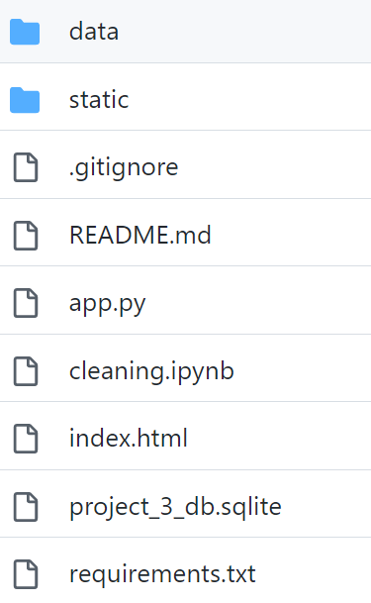
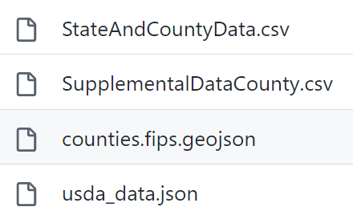
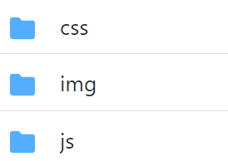


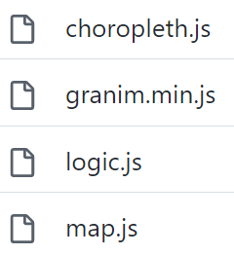
Project Structure

Slide 5

Data Cleanup
Import Data from USDA website
Cleaning data using selected Variable Code, including:
FFR16, FFRPTH16, GROC16, GROCPTH16, FMRKT18, FMRKTPTH18, and PCT_OBESE_ADULTS17
Give each selected Variable Code a proper name:
Fast Food Restaurants, Fast Food Restaurants Per 1,000 of Population, Grocery Stores, Grocery Stores Per 1,000 of Population, Farmers Markets’, ’Farmers Markets Per 1000 of Population, Obesity (%) with the Matching Value.
Make sure there is only one record for each county.
Data placed into an Sqlite database, and then the Flask-powered API would move the data from the database into a JSON file to use for the web page.
Result: combine all the variable codes to be one data set and apply them to the Map.

Slide 6
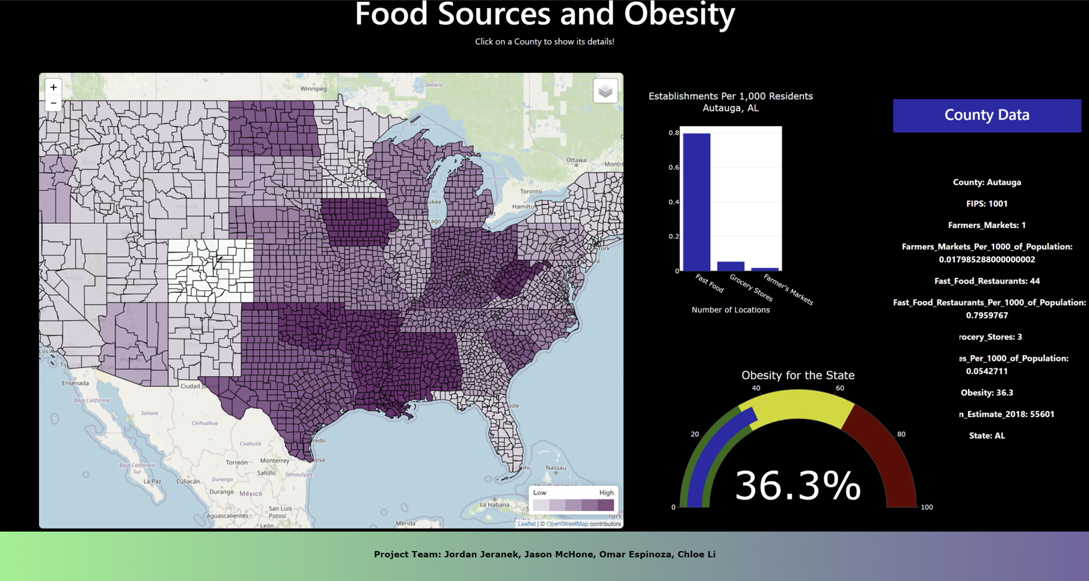
Dashboard
https://jjeranek.github.io/Project_3_Team_8/

Slide 7
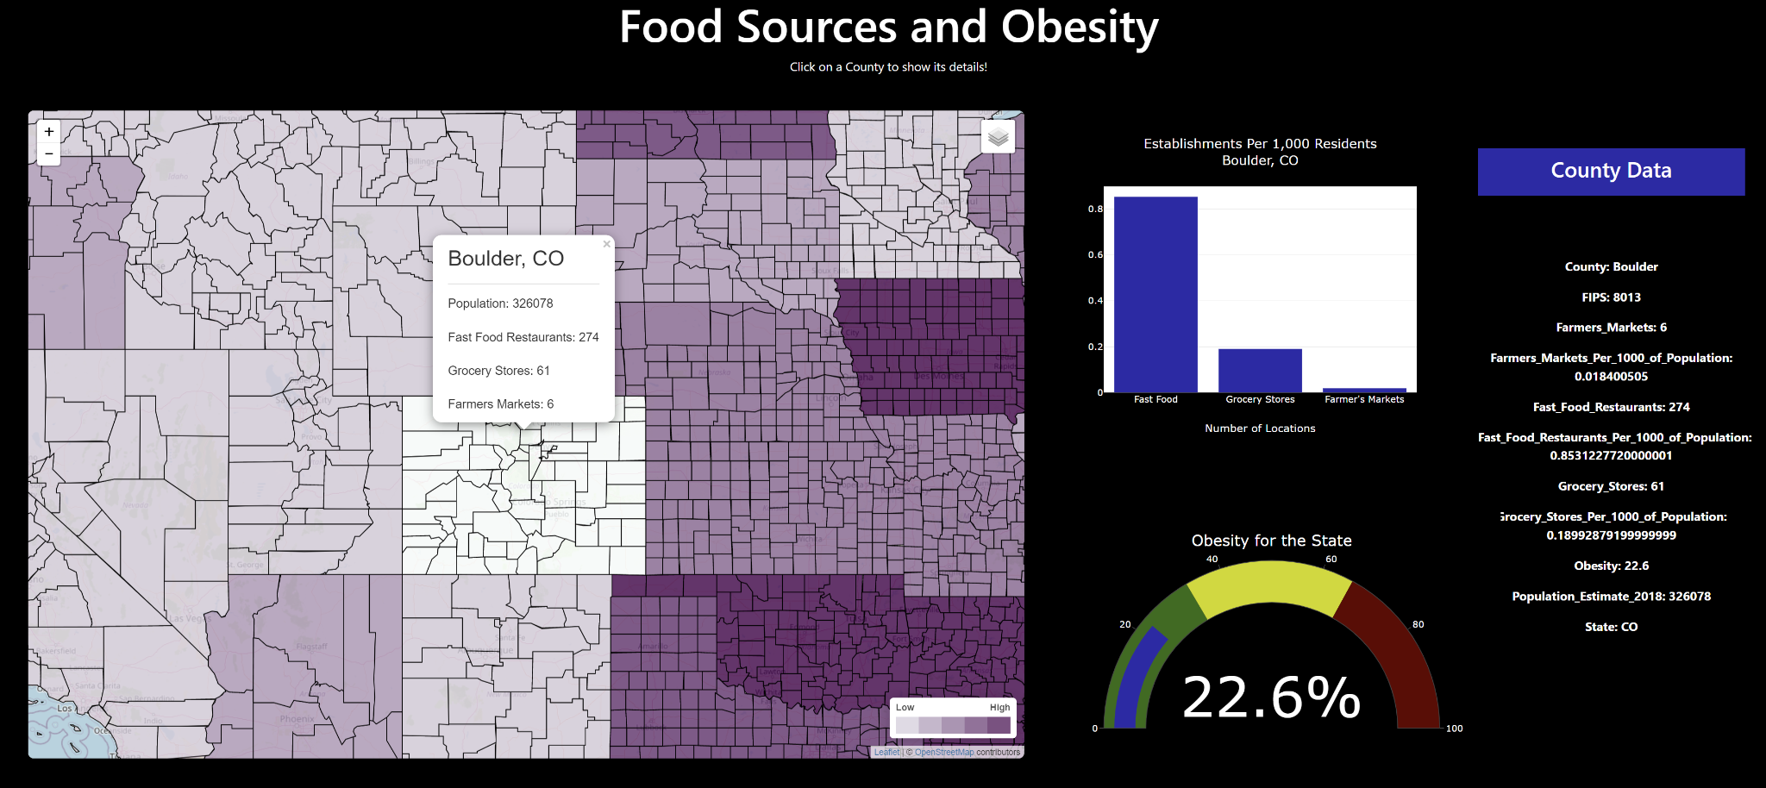

Slide 8
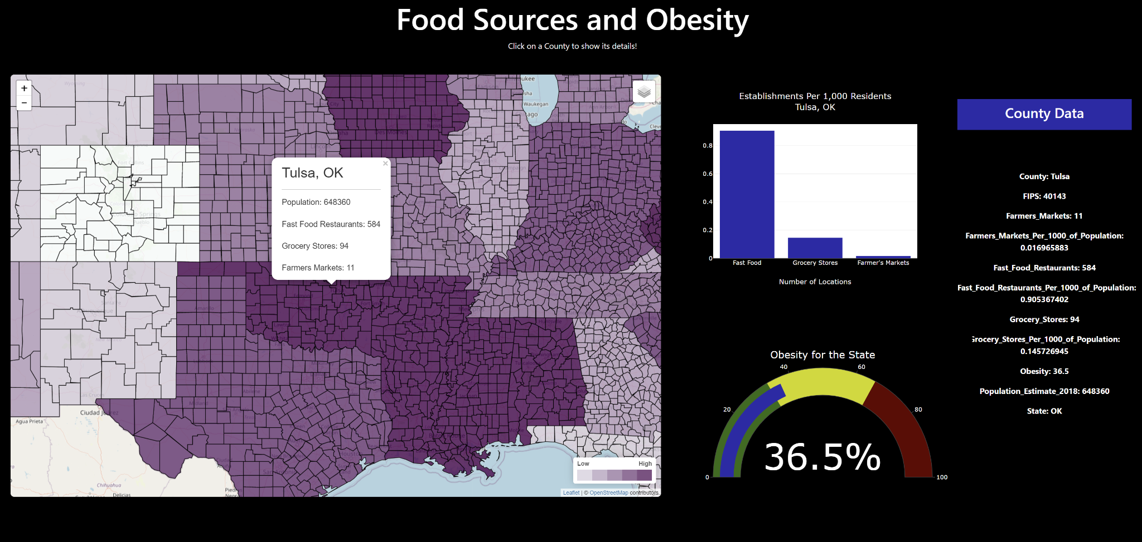

Slide 9
Dashboard Creation
Leaflet choropleth map used as the main interactive feature
Click on a county to update charts showing that county's details.
Map has different layers to show obesity rates, total fast food restaurants, total grocery stores, and total farmers markets across the country.
Bar chart represents the fast food restaurants, grocery stores, and farmers markets per 1000 residents for the county.
Gauge chart represents obesity rate for the chosen county's state.
Side panel shows all of the data collected for the county.

Slide 10

Findings
Obesity and other health indicators are complex issues that cannot be reduced to a few variables. We studied food accessibility and were able to observe some trends. However, correlations were not significant.
Obesity prevalence grows with the number of fast food restaurants.
Obesity inversely proportional to the number of grocery stores and farmers’ markets.
County | State | Obesity (%)* | Fast food | Grocery | Farmers mkt
Jackson | WV | 38.1 (39.0) | 0.65 | 0.10 | 0.03
Ouray | CO | 22.6 (17.1) | 0.83 | 0.63 | 0.41
Teton | WY | 28.8 (10.5) | 0.86 | 0.47 | 0.13
* County obesity rates in parentheses
Notes:
Obesity grows 0.91% with each additional fast food restaurant in a county
Obesity drops by 4.6% with each additional grocery store in a county, and by 3.6% with farmer’s market.

Slide 11

Challenges Encountered
Running a choropleth map with information from two datasets resulted in using jQuery to combine the datasets before entering into map creation.
Initially attempted to house data in MongoDB, but struggled to get data back out via Flask. Changed to Sqlite instead.
GitHub Pages loaded the page differently than Live Server. CSS was adjusted to fix the issue.
Identifying an error in the data sets took longer than anticipated because of a lack of experience with the error being presented.

Slide 12
Future Work
Update dataset with county-level numbers of obesity (dataset used only has state averages).
Change panel setup to output information in a nicer-looking way.
Add hover feature to map to at least display the hovered county name. (Attempted, but unsuccessful).
Add references to charts, for comparisons (e.g., state or national averages)

Slide 13

Questions?

